Slide 1

FeeCo - Next Gen Feedback Collection Portal
Swati Kanchan
Roll - 15/CS/95
Project Guide - Dr. Debasis Mitra
Dept. of Computer Science and Engineering
National Institute of Technology, Durgapur

Slide 2
Abstract
Feedbacks provide valuable information that will be used to make important decisions for the future.
The feedback form is used for any type of user, clients, customer to rate an event and provide feedback by using this form.
This is a project in which a hassle-free platform is created for generating feedback forms and sending those form links to people along with a One-Time-Password (OTP) via mails. The form receivers can then fill those forms by clicking on the link provided and using the OTP.
An automatic feature is added which summarizes the feedback comments (which is in the form of text) for the feedback creator.

Slide 3
Literature review
SurveyMonkey is an online survey development cloud-based software as a service company.
The basic version of SurveyMonkey is free;
create and send a survey with up to 10 questions or elements
view up to 100 responses per survey
an enhanced version is also available at a cost.
It offers a free account (Basic plan) and three paid options.
LimeSurvey is a free and open source online statistical survey web app written in PHP
it has its limitations when it comes to some complex question types, as it has its own set of default questions.

Slide 4
Software Requirements
● System requirements:
Server installed with NodeJS: This application’s backend website needs to be deployed on a server which needs to be installed with NodeJS from where all the APIs would be accessible for the end-users computer or mobile.
● Technology Stack:
■ NodeJS v10.9.0 [4]
■ ExpressJS ^4.16.4 [5]
■ Angular v6.1.3 [6]
■ MongoDB v4.0.5 [7]
■ MongooseJS ^5.4.12 [8]
■ Sumy [9]
■ Python 3 [10]

Slide 5
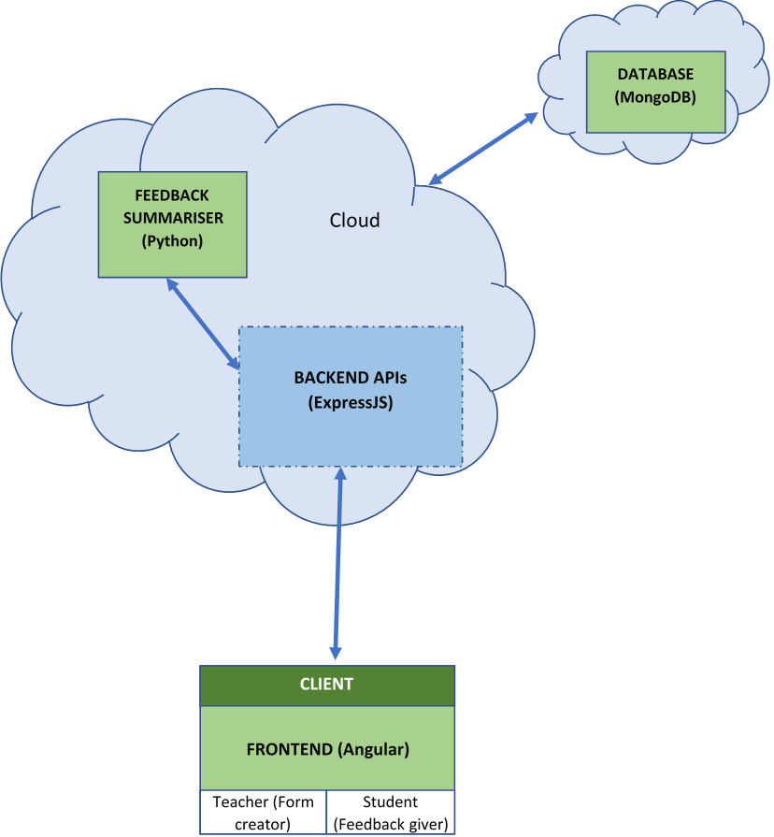
WHOLE ARCHITECTURE
The whole architecture of this project have 2 servers installed in the cloud, one for the backend APIs and feedback summarizer, and another for the MongoDB database. The client or the frontend can then be accessed through the hosted website’s domain name or IP address.

Slide 6
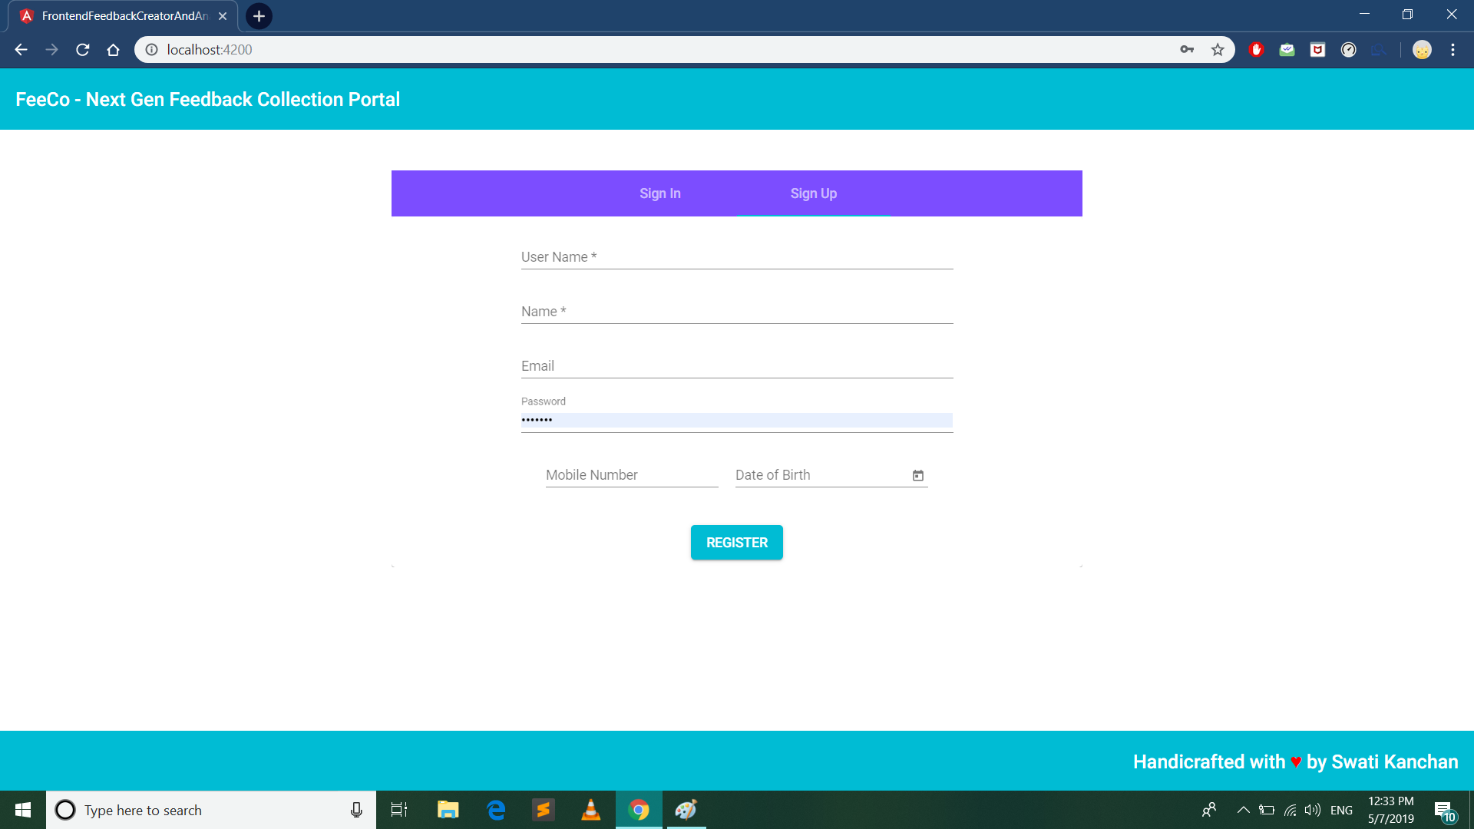
Demonstration
Step 1: Register as a new user with the following details.

Slide 7
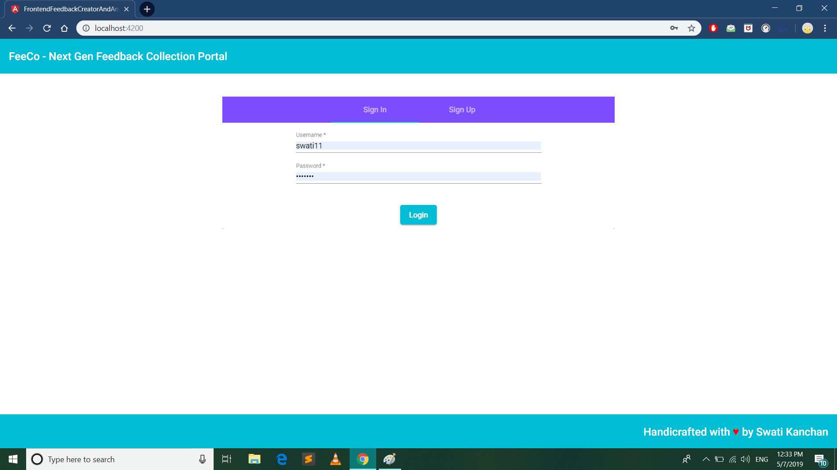
Demonstration (..continued)
Step 2: Sign-up with the username and password you had set while registering

Slide 8
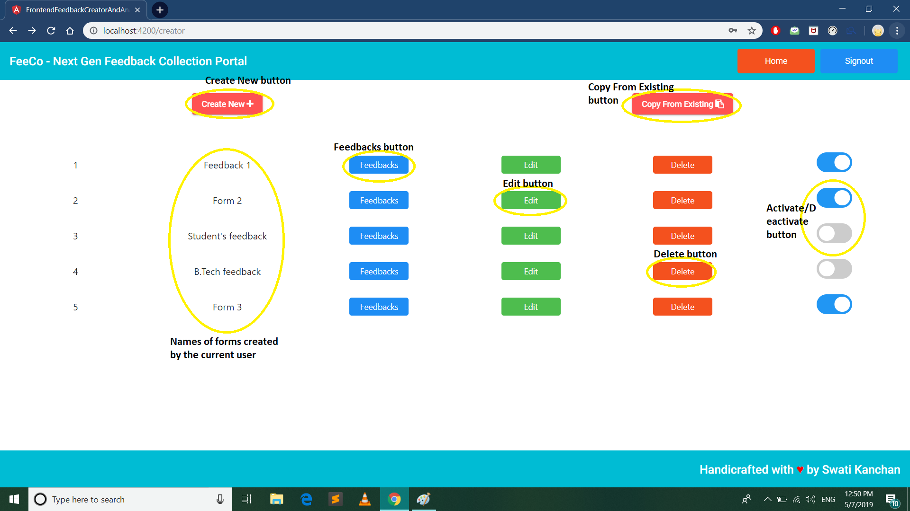
Demonstration (..continued)
Step 3: This is the user Dashboard to view, edit, activate/deactivate or delete a form.

Slide 9
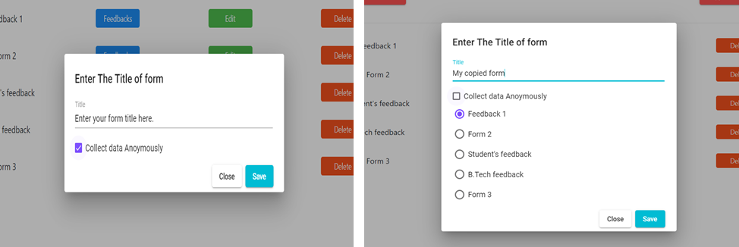
Demonstration (..continued)
Step 4: User can create new forms either a) by clicking on “Create New” or b) by clicking on “Copy From Existing” button.

Slide 10
Demonstration (..continued)
Step 5: Click on “Edit” button to edit it

Slide 11
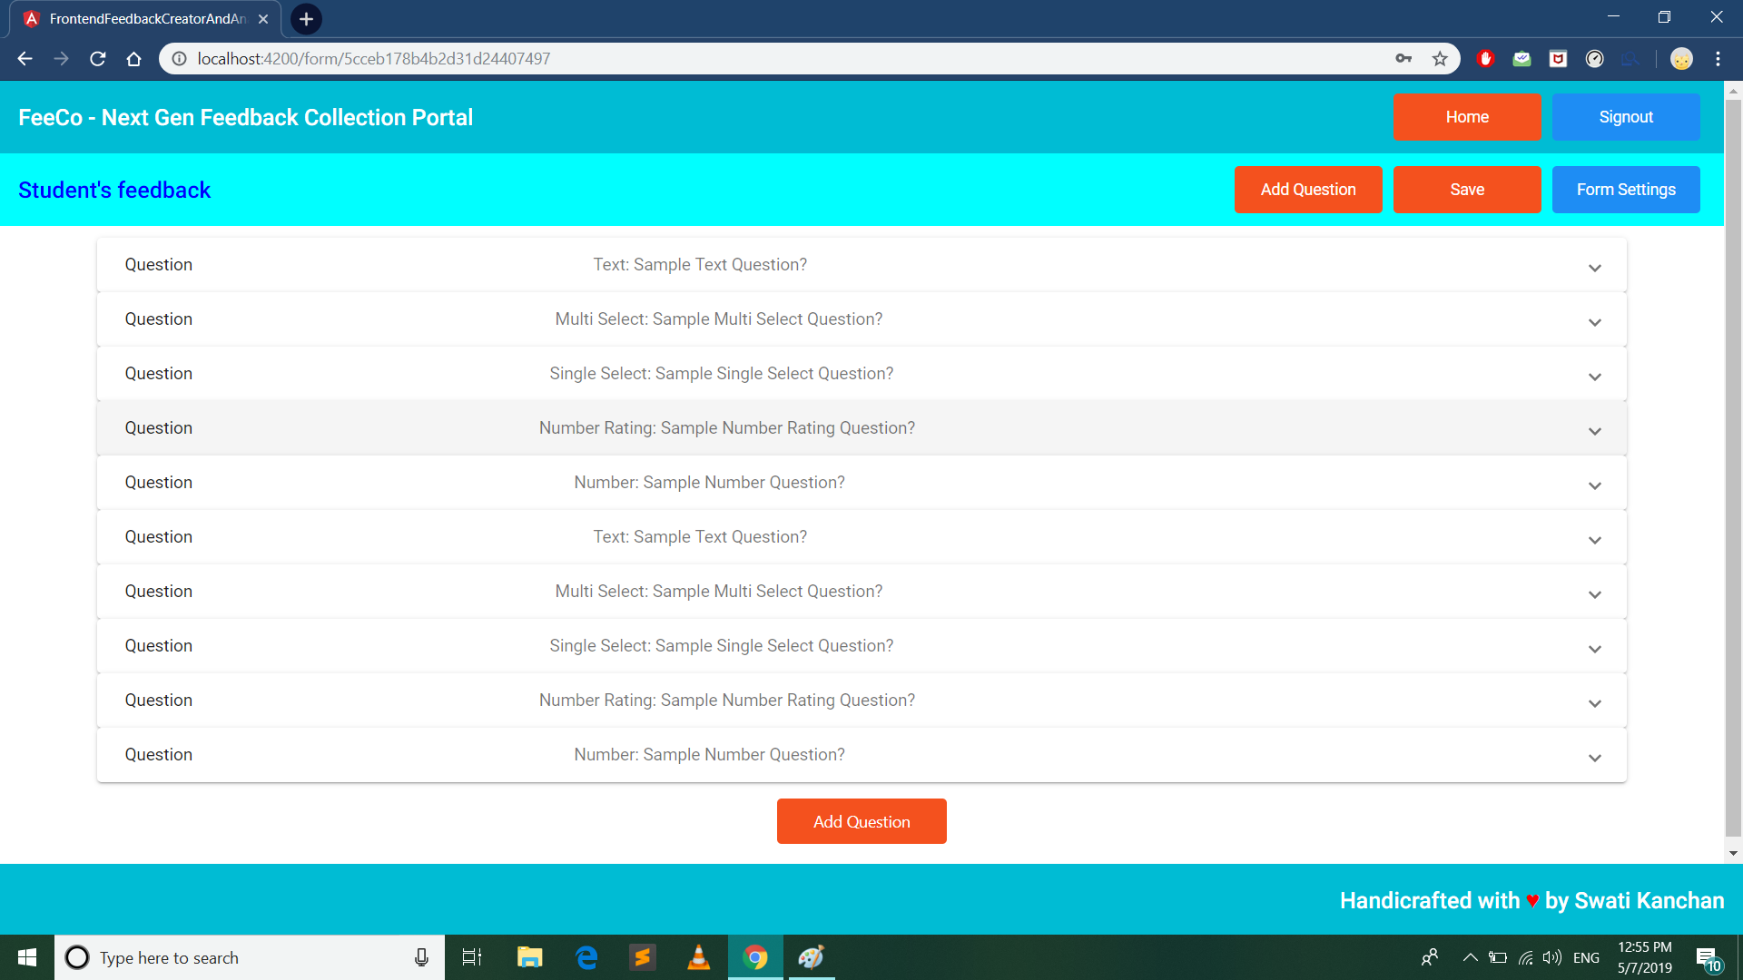
Demonstration (..continued)
Step 7: Add questions. Finally Click on “Save” button to save the changes. To make more changes click on “Form Settings” button

Slide 12
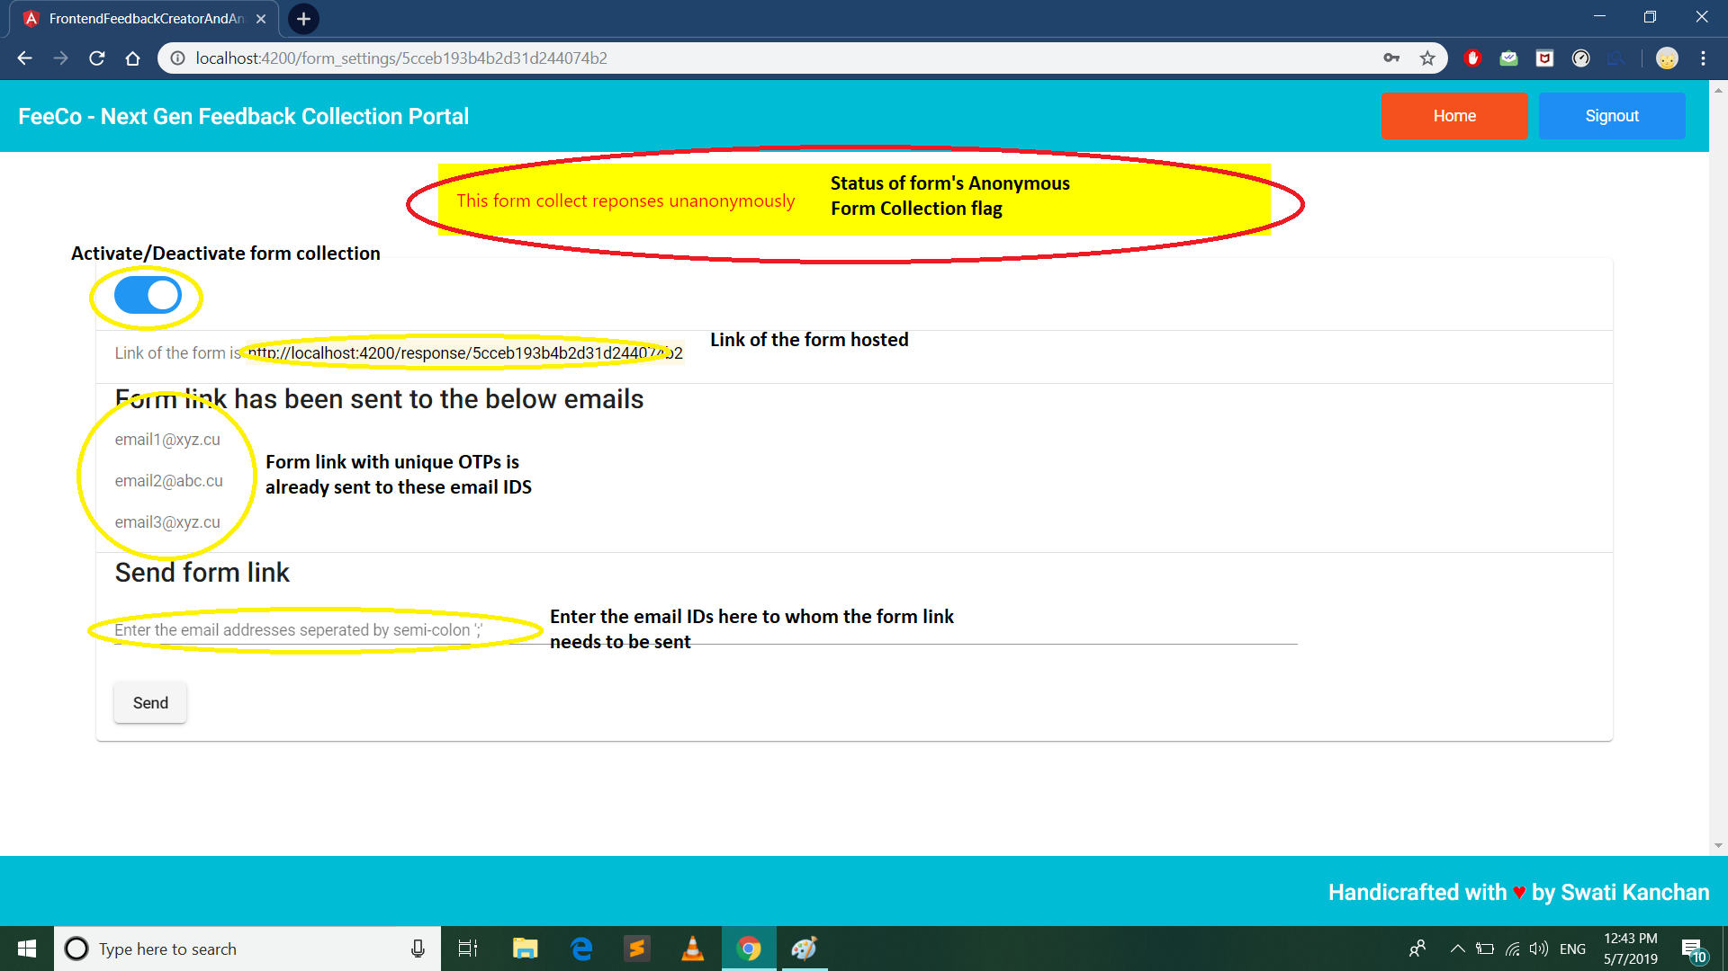
Demonstration (..continued)
Step 8: Enable/Disable the form, get the form link, send emails with form links. Also see if the form collects responses anonymously or not.

Slide 13
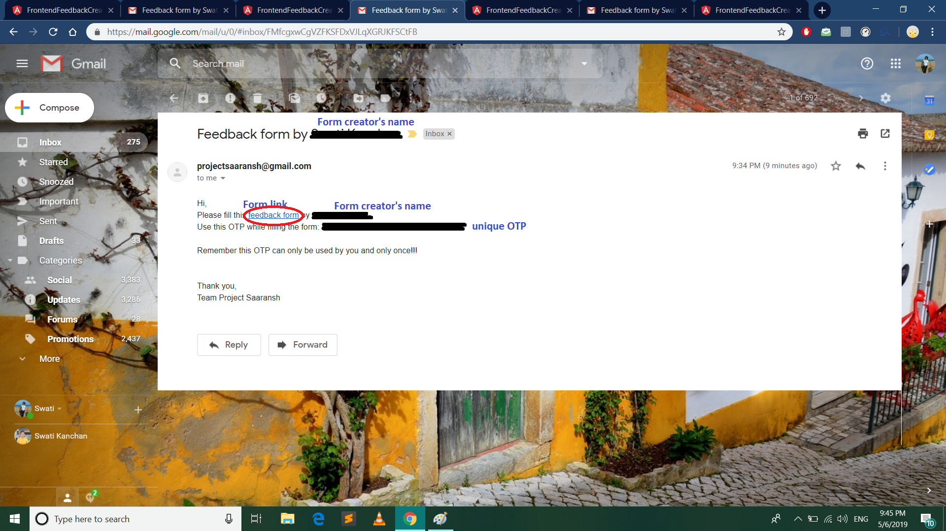
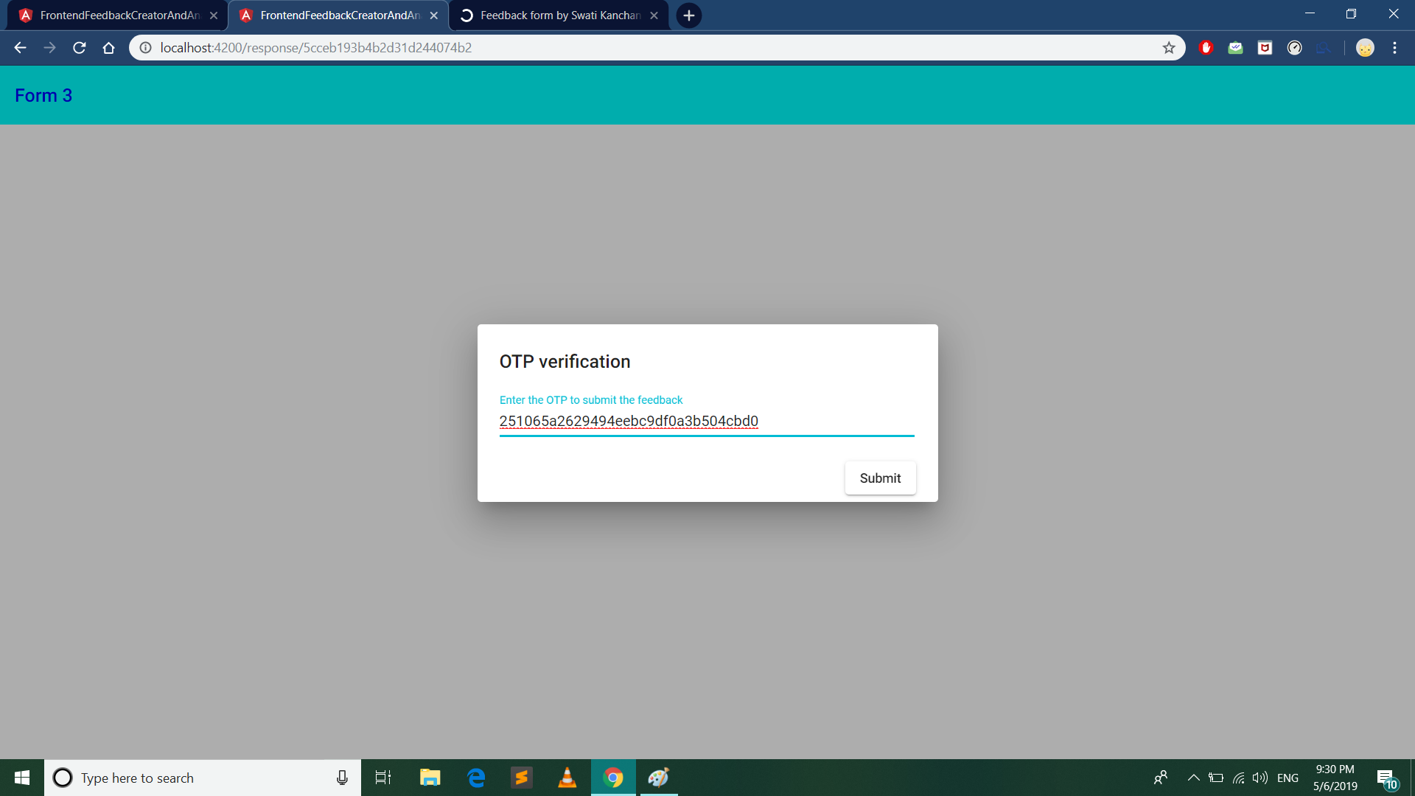
Demonstration (..continued)
Step 9: Emails are received in this way, with a form link, form-creator’s name and a unique OTP. Click on the form link
Step 10: Enter the OTP sent in the mail to get access of the form and fill.

Slide 14
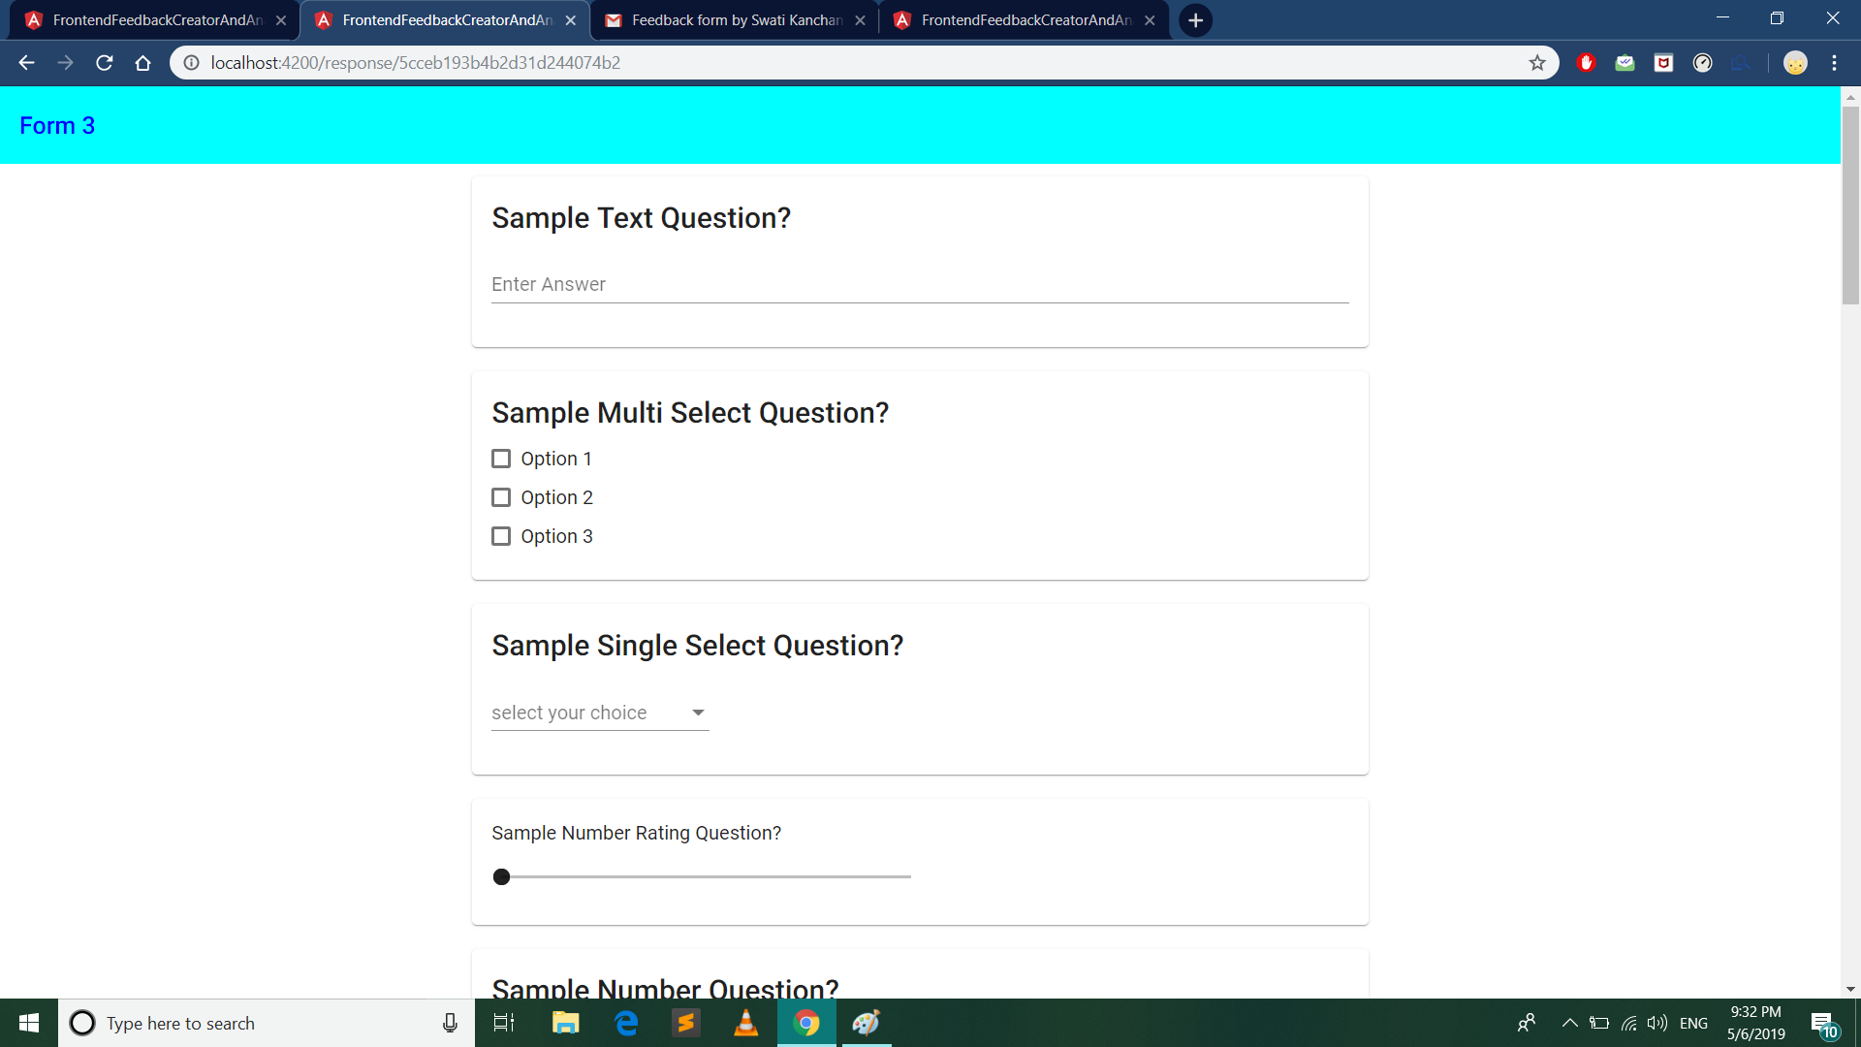
Demonstration (..continued)
Step 11: Fill the form

Slide 15
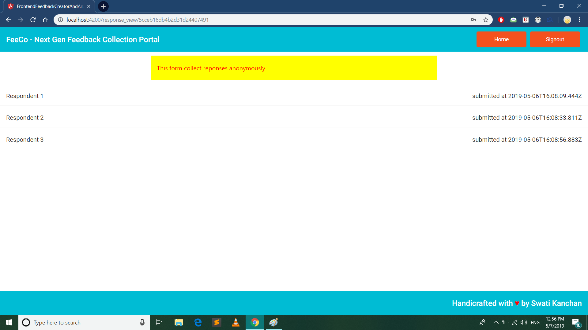
Demonstration (..continued)
Step 12: View the responses by clicking on “Feedbacks” button of form on the Dashboard.
Non-anonymously -> respondents’ email IDs
Anonymously -> just the term “Respondent #”
Click on a respondent to view their response.

Slide 16
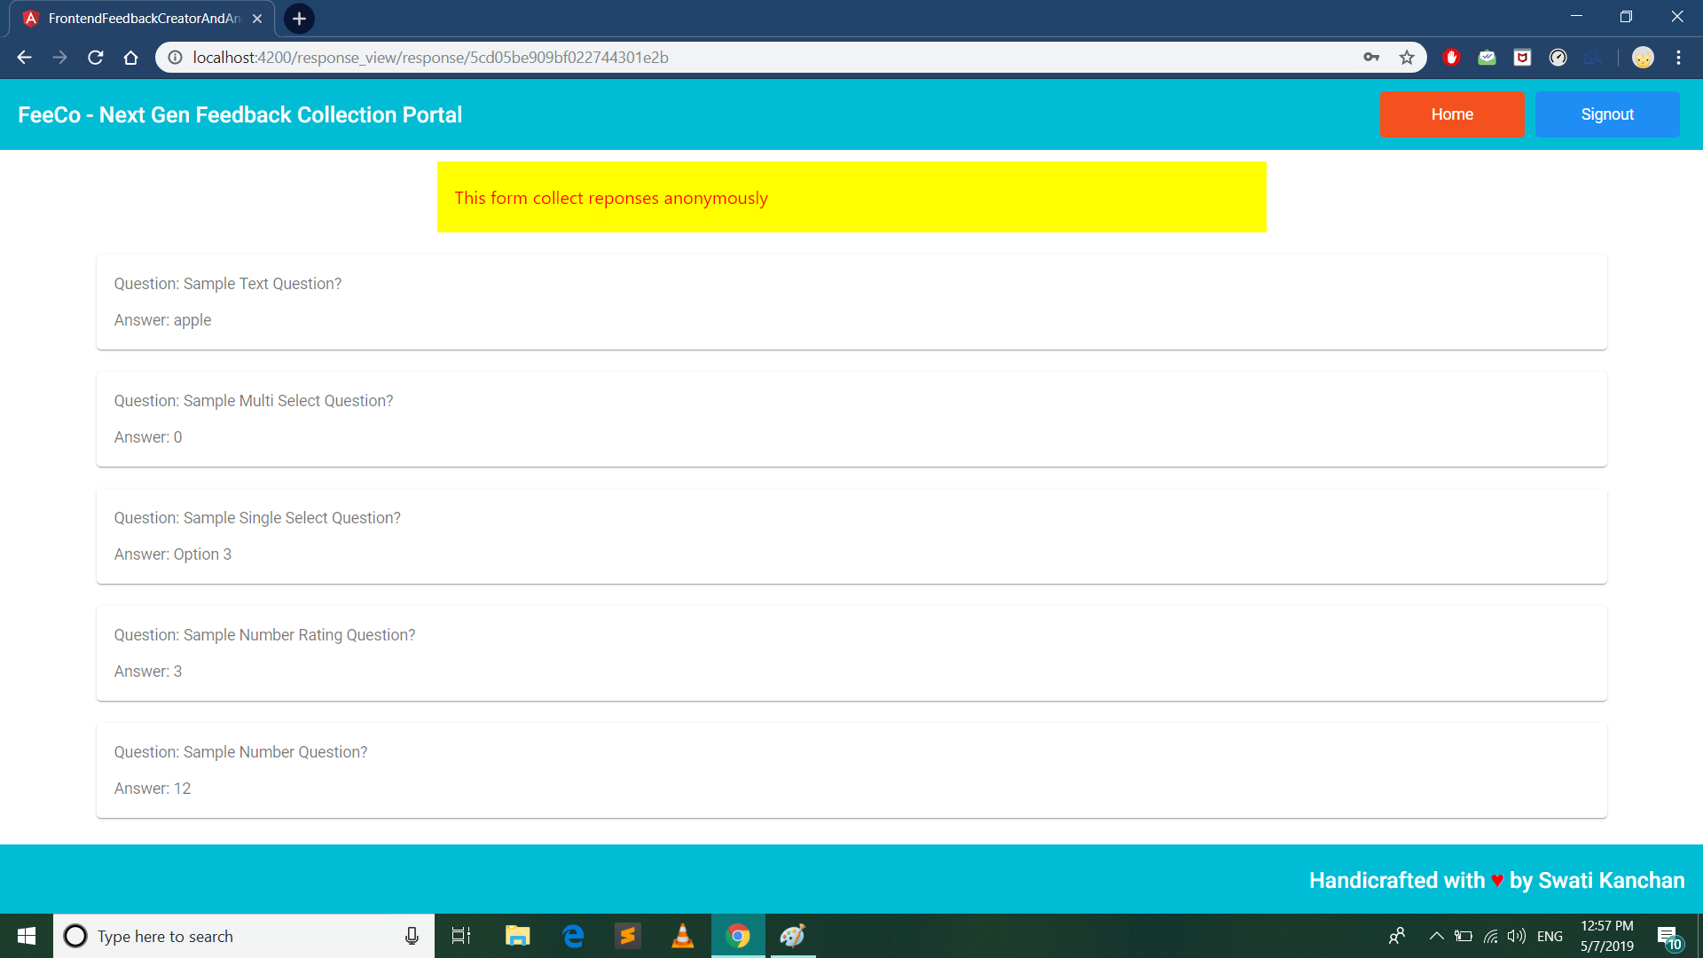
Demonstration (..continued)
Step 13: View the response of the respondent. Each question is mapped with its answer given.

Slide 17
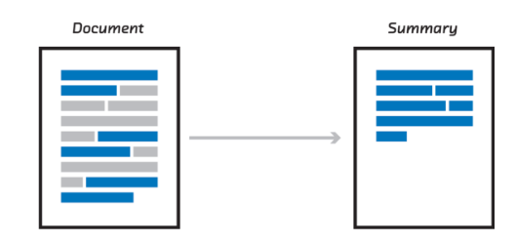
Text summarizer implementation
We have used Extractive Text Summarization Techniques With Sumy which perform summarization by picking portions of texts and constructing a summary.

Slide 18
SUMY
Simple library and command line utility for extracting summary from HTML pages or plain texts.
Contains various implementations such as Luhn, Text Rank, Lex Rank, LSA, etc.
The github link: sumy
The summarization technique we have used is Latent Semantic Analysis (LSA).

Slide 19
LATENT SEMANTIC ANALYSIS
Unsupervised method of summarization
Combines term frequency techniques with singular value decomposition to summarize texts
Also known as LSI (Latent Semantic Index) LSA uses bag of word (BoW) model, which results in a term-document matrix (occurrence of terms in a document)

Slide 20
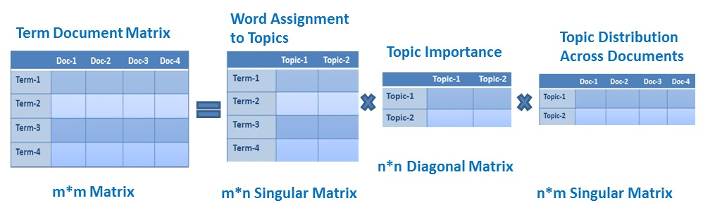
LATENT SEMANTIC ANALYSIS (Continued…)
Bag of Words model (BoW)
Rows represent terms and columns represent documents.
LSA learns latent topics by performing a matrix decomposition on the document-term matrix using Singular value decomposition.
Typically used as a dimension reduction or noise reducing technique.

Slide 21
LATENT SEMANTIC ANALYSIS (Continued…)
Suppose the input document contains the following text:

Slide 22
LATENT SEMANTIC ANALYSIS (Continued…)
“I think it would have been more engaging if more board work was involved like data structures class. Also the absence of stress on attendance and availability of slides led to students feeling like they could do without attending the classes. The assignments were not discussed later for those who were unable to do it on their own. Great learning about VLSI, especially to know where it is applicable in computer science. Although the course, as well as the instructors, were quite good, the problem was students not attending classes(including me). I missed few classes in between as a result of which I couldn't catch up with topics. I've a deep regret that I couldn't learn hardware topics well [including Computer Architecture in 4th sem(few topics were skipped because of lack of time as students were busy in Recs and other stupid stuffs), Digital electronics(taught by ECE dept - only things we were taught were number system conversion, boolean expression, k-map, etc skipping important topics like flip-flop. I still have very less idea about flip-flops) ] I've got a big regret that I didn't study those topics well(many other topics as well) Professors/Teachers are doing good. The problem is lack of seriousness in students and confidence in the fact that they can pass the exam in one night. DM Sir has always been the perfect and most knowledgeable instructor and professor. He always instills the required information about the topic. I feel privileged to be able to attend his classes. Extremely enjoyed the course. I had always been under the impression that VLSI is a core hardware subject and has got nothing to do with software related stuff. I was really amazed to see how problems from hardware domain is mapped to software/computing domain and solved. Learned a lot of things from this class. Here are a few things which I felt during this course: I feel the course would have been better if the instructor would have not used slides and had written points on board. Being a lazy student myself, slides tend to make me more lazy. It gives a feeling that 'oh everything is there in slides, I can always go to hostel room and study' and this sometimes makes my brain lazy during the class which should not be the case. Two assignments were given during the course to be solved by students which are really fun and interesting. Would be nice if some more projects (or simulations) were given to get our hands a bit more dirty. Overall the course was excellent.”

Slide 23
LATENT SEMANTIC ANALYSIS (Continued…)
The output of the summariser was:
“Great learning about VLSI, especially to know where it is applicable in computer science.
I had always been under the impression that VLSI is a core hardware subject and has got nothing to do with software related stuff.
Here are a few things which I felt during this course: I feel the course would have been better if the instructor would have not used slides and had written points on board.
It gives a feeling that 'oh everything is there in slides, I can always go to hostel room and study' and this sometimes makes my brain lazy during the class which should not be the case.
Two assignments were given during the course to be solved by students which are really fun and interesting.”

Slide 24
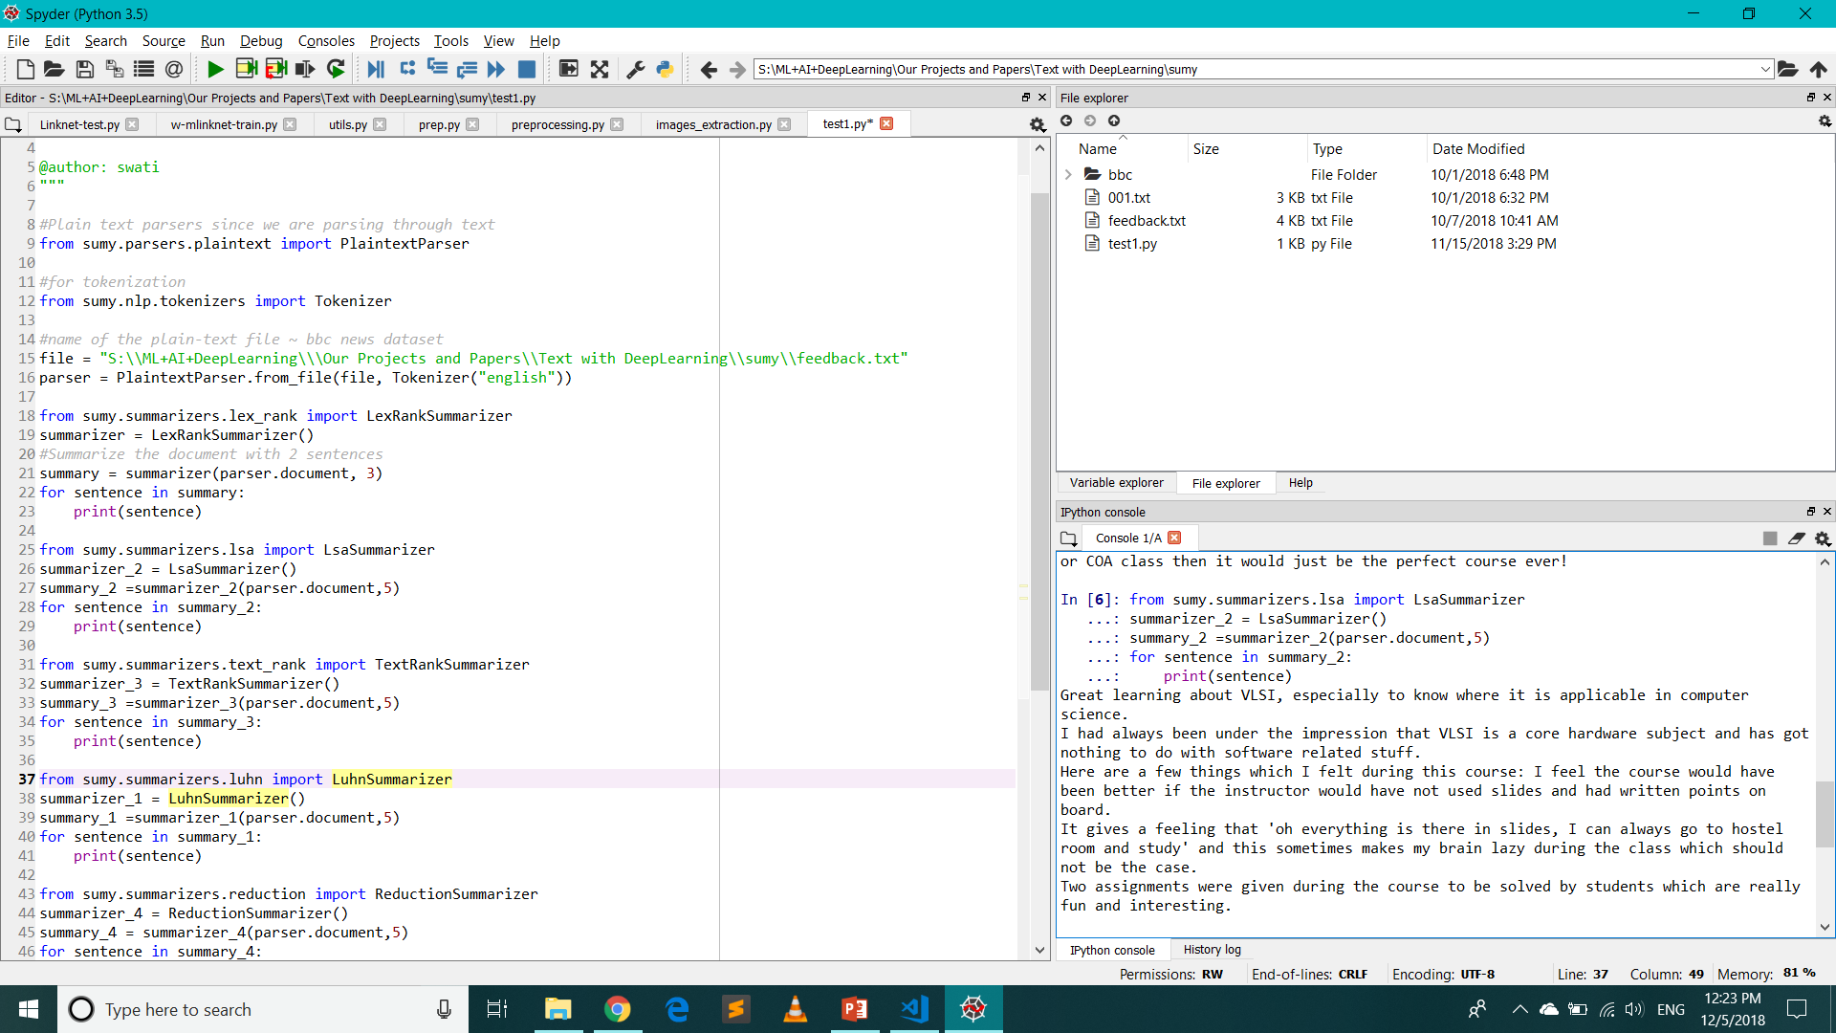
Summary Output in SPYDER console

Slide 25
Future work
Multilingual forms: Support of many regional and international languages for the respondent.
Question types: Currently our form supports 5 types of question, we can add more question types as per the requirement
Visualize data response:
Create statistics and engaging graphs with a few clicks for all questions of our feedback form.
Filter the results based on certain responses. Export the statistics to Excel or PDF.
Dynamic questions: Create questions based on previous answers. Use answers given to your previous questions to validate and refine your results
Adding plugins like trello, google calendar, etc.

Slide 26
References
https://angular.io/docs
https://www.tutorialspoint.com/css/what_is_css.htm
https://medium.freecodecamp.org/what-exactly-is-node-js-ae36e97449f5
https://www.javatpoint.com/what-is-expressjs
https://www.mongodb.com/what-is-mongodb
https://medium.com/@ondenyi.eric/extractive-text-summarization-techniques-with-sumy-3d3b127a0a32

